Slide 1
EE 5301 – VLSI Design Automation I
Part VII: High Level Synthesis
Kia Bazargan
University of Minnesota

Slide 2
References and Copyright
Textbooks referred (none required)
  [Mic94] G. De Micheli
  “Synthesis and Optimization of Digital Circuits”
  McGraw-Hill, 1994.
Slides used: (Modified by Kia when necessary)
  [©Gupta] © Rajesh Gupta
  UC-Irvine
  http://www.ics.uci.edu/~rgupta/ics280.html

Slide 3
High Level Synthesis (HLS)
The process of converting a high-level description of a design to a netlist
  Input:
    High-level languages (e.g., C)
    Behavioral hardware description languages (e.g., VHDL)
    Structural HDLs (e.g., VHDL)
    State diagrams / logic networks
  Tools:
    Parser
    Library of modules
  Constraints:
    Area constraints (e.g., # modules of a certain type)
    Delay constraints (e.g., set of operations should finish in λ clock cycles)
  Output:
    Operation scheduling (time) and binding (resource)
    Control generation and detailed interconnections

Slide 4
High-Level Synthesis Compilation Flow
Lex
Compilation
front-end
x = a + b × c + d
Parse
+
+
Behavioral
Optimization
Intermediate
form
+
+
×
×
a
d
b
c
a
b
c
d
Arch synth
Logic synth
HLS backend
Lib Binding

Slide 5
Behavioral Optimization
Techniques used in software compilation
  Expression tree height reduction
  Constant and variable propagation
  Common sub-expression elimination
  Dead-code elimination
  Operator strength reduction (e.g., *4 → << 2)
Typical Hardware transformations
  Conditional expansion
    If (c) then x=A else x=B
    ➔ compute A and B in parallel, x=(C)?A:B
  Loop expansion
    Instead of three iterations of a loop, replicate the loop body three times
c
A
x
B

Slide 6
Architectural Synthesis
Deals with “computational” behavioral descriptions
  Behavior as sequencing graph
  (aka dependency graph, or data flow graph DFG)
  Hardware resources as library elements
    Pipelined or non-pipelined
    Resource performance in terms of execution delay
  Constraints on operation timing
  Constraints on hardware resource availability
  Storage as registers, data transfer using wires
Objective
  Generate a synchronous, single-phase clock circuit
  Might have multiple feasible solutions (explore tradeoff)
  Satisfy constraints, minimize objective:
    Maximize performance subject to area constraint
    Minimize area subject to performance constraints
[©Gupta]

Slide 7
Synthesis in Temporal Domain
Scheduling and binding can be done in different orders or together
Schedule:
  Mapping of operations to time slots (cycles)
  A scheduled sequencing graph is a labeled graph
NOP
NOP
1
×
×
×
×
+
1
×
×
+
2
×
×
+
<
2
×
×
<
3
-
3
-
×
×
-
-
+
4
4
NOP
NOP
[©Gupta]
Notes:
In the left schedule, how many multipliers do we need? How many ALU’s?
What about the schedule on the right?

Slide 8
Operation Types
For each operation, define its type.
For each resource, define a resource type,
and a delay (in terms of # cycles)
T is a relation that maps an operation to a resource type that can implement it
  T : V → {1, 2, ..., n_{res}}.
More general case:
  A resource type may implement more than one operation type (e.g., ALU)
Resource binding:
  Map each operation to a resource with the same type
  Might have multiple options
[©Gupta]

Slide 9
Schedule in Spatial Domain
Resource sharing
  More than one operation bound to same resource
  Operations have to be serialized
  Can be represented using hyperedges (define vertex partition)
NOP
1
×
×
×
×
+
2
×
×
+
<
3
-
-
4
NOP
[©Gupta]

Slide 10
Scheduling and Binding
Resource constraints:
  Number of resource instances of each type
  {a_{k} : k=1, 2, ..., n_{res}}.
Scheduling:
  Labeled vertices φ (v₃)=1.
Binding:
  Hyperedges (or vertex partitions) β (v₂)=adder1.
Cost:
  Number of resources ≈ area
  Registers, steering logic (Muxes, busses), wiring, control unit
Delay:
  Start time of the “sink” node
  Might be affected by steering logic and schedule (control logic) – resource-dominated vs. ctrl-dominated
← Resource dominated
← Control dominated

Slide 11
Architectural Optimization
Optimization in view of design space flexibility
A multi-criteria optimization problem:
  Determine schedule φ and binding β.
  Under area Α, latency λ and cycle time τ objectives
Find non-dominated points in solution space
Solution space tradeoff curves:
  Non-linear, discontinuous
  Area / latency / cycle time (more?)
Evaluate (estimate) cost functions
Unconstrained optimization problems for resource dominated circuits:
  Min area: solve for minimal binding
  Min latency: solve for minimum λ scheduling
[©Gupta]

Slide 12
Scheduling and Binding
Cost λ and Α determined by both φ and β.
  Also affected by floorplan and detailed routing
β affected by φ:
  Resources cannot be shared among concurrent ops
φ affected by β:
  Resources cannot be shared among concurrent ops
  When register and steering logic delays added to execution delays, might violate cycle time.
Order?
  Apply either one (scheduling, binding) first
[©Gupta]

Slide 13
How Is the Datapath Implemented?
Assuming the following schedule and binding
Wires between
modules?
Input selection?
How does binding /
scheduling affect
congestion?
How does binding /
scheduling affect
steering logic?
×
×
+
1
×
×
<
2
-
×
×
3
-
+
4

Slide 14
Operation Scheduling
Input:
  Sequencing graph G(V, E), with n vertices
  Cycle time τ.
  Operation delays D = {d_{i}: i=0..n}.
Output:
  Schedule φ determines start time t_{i} of operation v_{i}.
  Latency λ = t_{n} – t₀.
Goal: determine area / latency tradeoff
Classes:
  Non-hierarchical and unconstrained
  Latency constrained
  Resource constrained
  Hierarchical
[©Gupta]

Slide 15
Min Latency Unconstrained Scheduling
Simplest case: no constraints, find min latency
Given set of vertices V, delays D and a partial order > on operations E, find an integer labeling of operations φ: V → Z⁺ Such that:
  t_{i} = φ(v_{i}).
  t_{i} ≥ t_{j} + d_{j} ∀ (v_{j}, v_{i}) ∈ E.
  λ = t_{n} – t₀ is minimum.
Solvable in polynomial time
Bounds on latency for resource constrained problems
ASAP algorithm used: topological order

Slide 16
ASAP Schedules
  Schedule v₀ at t₀=0.
  While (v_{n} not scheduled)
    Select v_{i} with all scheduled predecessors
    Schedule v_{i} at t_{i} = max {t_{j}+d_{j}}, v_{j} being a predecessor of v_{i}.
  Return t_{n}.
NOP
1
×
×
×
×
+
2
×
×
+
<
3
-
-
4
NOP

Slide 17
ALAP Schedules
  Schedule v_{n} at t₀=λ.
  While (v₀ not scheduled)
    Select v_{i} with all scheduled successors
    Schedule v_{i} at t_{i} = min {t_{j}-d_{j}}, v_{j} being a succecessor of v_{i}.
NOP
1
×
×
2
×
×
3
-
×
×
+
-
+
<
4
NOP

Slide 18
Resource Constraint Scheduling
Constrained scheduling
  General case NP-complete
  Minimize latency given constraints on area or
  the resources (ML-RCS)
  Minimize resources subject to bound on latency (MR-LCS)
Exact solution methods
  ILP: Integer Linear Programming
  Hu’s heuristic algorithm for identical processors
Heuristics
  List scheduling
  Force-directed scheduling

Slide 19
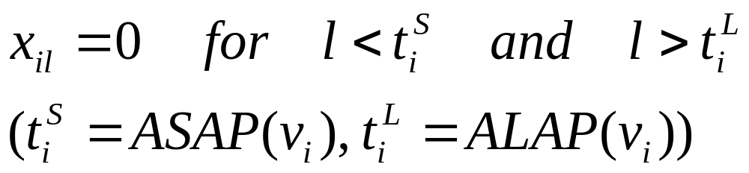
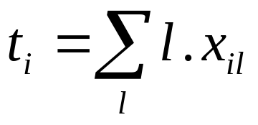
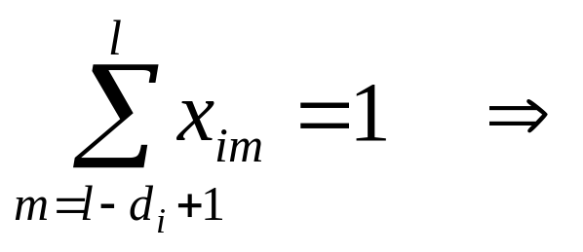
ILP Formulation of ML-RCS
Use binary decision variables
  i = 0, 1, ..., n
  l = 1, 2, ..., λ’+1 λ’ given upper-bound on latency
  x_{il} = 1 if operation i starts at step l, 0 otherwise.
Set of linear inequalities (constraints),
and an objective function (min latency)
Observations
  t_{i} = start time of op i.
  is op v_{i} (still) executing at step l?
?
[Mic94] p.198
Notes:
- Make sure that you understand the

Slide 20
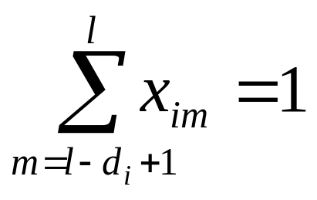
Start Time vs. Execution Time
For each operation v_{i} , only one start time
If d_{i}=1, then the following questions are the same:
  Does operation v_{i} start at step l?
  Is operation v_{i} running at step l?
But if d_{i}>1, then the two questions should be formulated as:
  Does operation v_{i} start at step l?
    Does x_{il} = 1 hold?
  Is operation v_{i} running at step l?
    Does the following hold?
?

Slide 21
Operation v_{i} Still Running at Step l ?
Is v₉ running at step 6?
  Is x_{9,6} + x_{9,5} + x_{9,4} = 1 ?
Note:
  Only one (if any) of the above three cases can happen
  To meet resource constraints, we have to ask the same question for ALL steps, and ALL operations of that type
4
4
4
v₉
5
5
v₉
5
6
v₉
6
6
x_{9,6}=1
x_{9,5}=1
x_{9,4}=1

Slide 22
Operation v_{i} Still Running at Step l ?
Is v_{i} running at step l ?
  Is x_{i,l} + x_{i,l-1} + ... + x_{i,l-di+1} = 1 ?
l-d_{i}+1
l-d_{i}+1
l-d_{i}+1
v_{i}
...
...
...
. . .
l-1
l-1
v_{i}
l-1
l
v_{i}
l
l
x_{i,l}=1
x_{i,l-1}=1
x_{i,l-di+1}=1

Slide 23
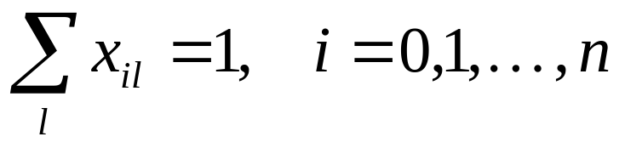
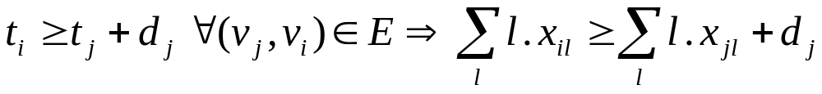
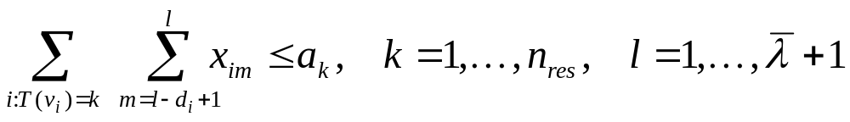
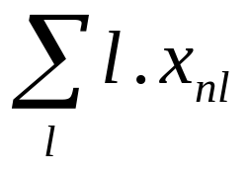
ILP Formulation of ML-RCS (cont.)
Constraints:
  Unique start times:
  Sequencing (dependency) relations must be satisfied
  Resource constraints
Objective: min c^{T}t.
  t =start times vector, c =cost weight (e.g., [0 0 ... 1])
  When c =[0 0 ... 1], c^{T}t =
Notes:
How can we graphically depict a resource constraint inequality?
How will the resource constraint inequality change if all operations have unit delay?
What does it mean to set c=[1 1...1]?
What will c^{T}t look like?
What schedule do we get?

Slide 24
ILP Example
Assume λ = 4
First, perform ASAP and ALAP
  (we can write the ILP without ASAP and ALAP, but using ASAP and ALAP will simplify the inequalities)
NOP
NOP
1
×
v1
×
v2
×
v6
×
v8
+
v10
1
×
v1
×
v2
2
×
v3
×
v7
+
v9
<
v11
2
×
v3
×
v6
3
-
v4
3
-
v4
×
v7
×
v8
+
v10
-
v5
-
v5
+
v9
<
v11
4
4
NOP
vn
NOP
vn

Slide 25
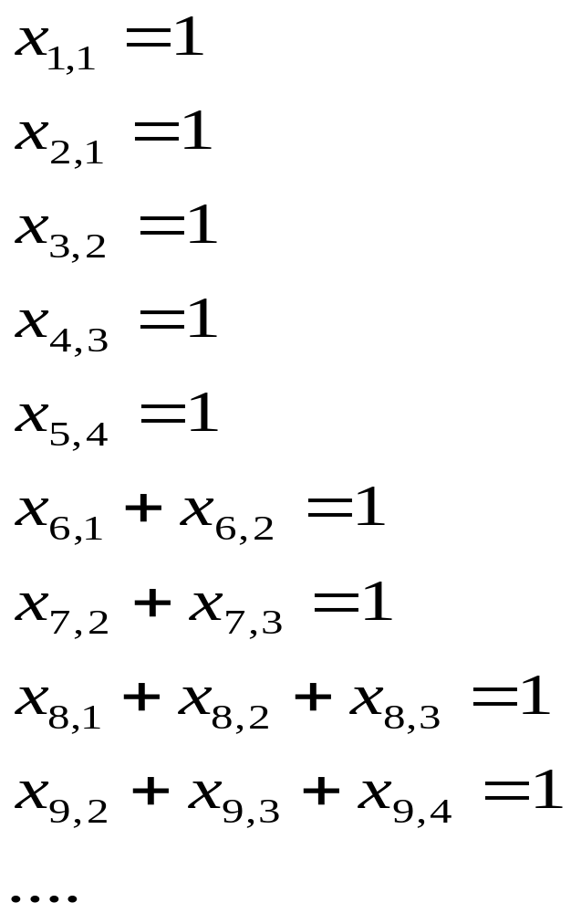
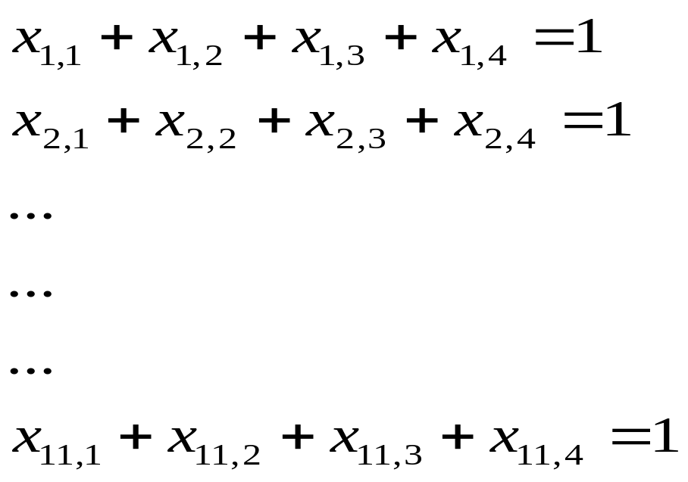
ILP Example: Unique Start Times Constraint
Without using ASAP and ALAP values:
Using ASAP and ALAP:

Slide 26
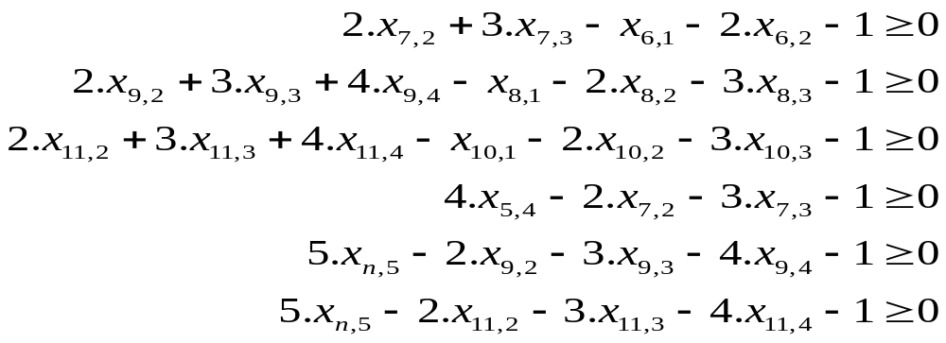
ILP Example: Dependency Constraints
Using ASAP and ALAP, the non-trivial inequalities are: (assuming unit delay for + and *)

Slide 27
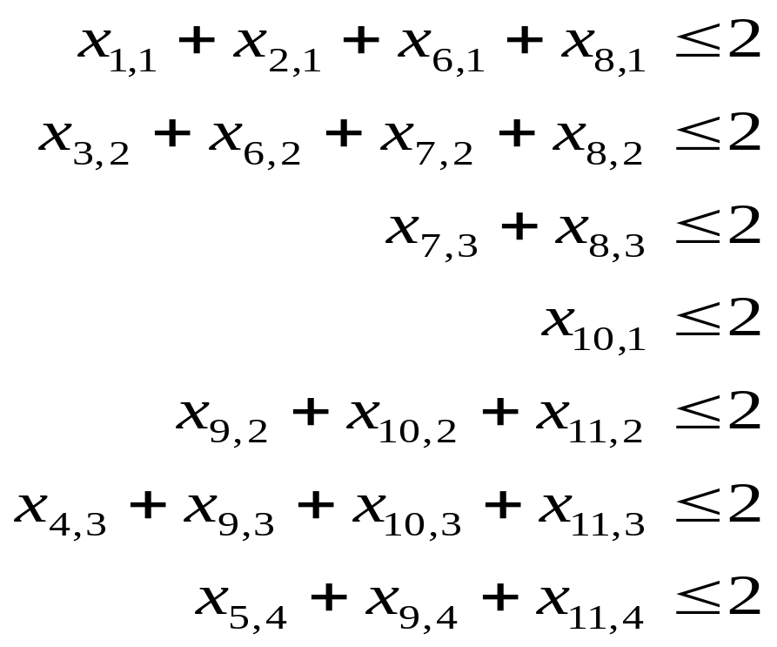
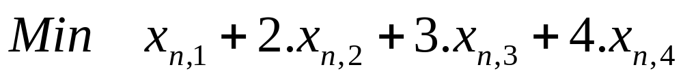
ILP Example: Resource Constraints
Resource constraints (assuming 2 adders and 2 multipliers)
Objective:
  Since λ=4 and sink has no mobility, any feasible solution is optimum, but we can use the following anyway:

Slide 28
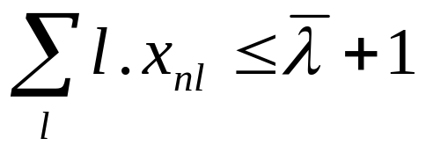
ILP Formulation of MR-LCS
Dual problem to ML-RCS
Objective:
  Goal is to optimize total resource usage, a.
  Objective function is c^{T}a , where entries in c
  are respective area costs of resources
Constraints:
  Same as ML-RCS constraints, plus:
  Latency constraint added:
  Note: unknown a_{k} appears in constraints.
[©Gupta]

Slide 29
Hu’s Algorithm
Simple case of the scheduling problem
  Operations of unit delay
  Operations (and resources) of the same type
Hu’s algorithm
  Greedy
  Polynomial AND optimal
  Computes lower bound on number of resources for a given latency
  OR: computes lower bound on latency subject to resource constraints
Basic idea:
  Label operations based on their distances from the sink
  Try to schedule nodes with higher labels first
  (i.e., most “critical” operations have priority)
[©Gupta]

Slide 30
Hu’s Algorithm
  HU (G(V,E), a) {
  Label the vertices // label = length of longest path
  passing through the vertex
  l = 1
  repeat {
  U = unscheduled vertices in V whose
  predecessors have been scheduled
  (or have no predecessors)
  Select S ⊆ U such that |S| ≤ a and labels in S
  are maximal
  Schedule the S operations at step l by setting
  t_{i}=l, i: v_{i} ∈ S.
  l = l + 1
  } until v_{n} is scheduled.
  }

Slide 31
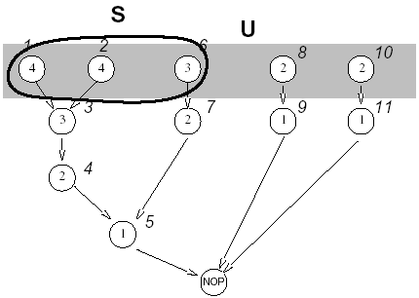
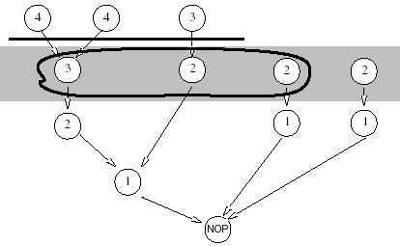
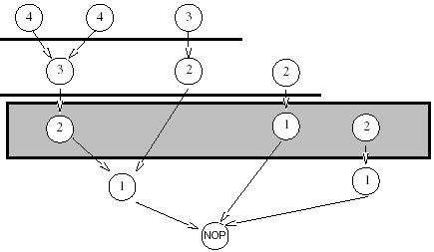
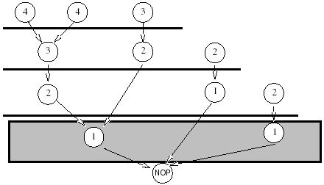
Hu’s Algorithm: Example
[©Gupta]

Slide 32
List Scheduling
Greedy algorithm for ML-RCS and MR-LCS
  Does NOT guarantee optimum solution
Similar to Hu’s algorithm
  Operation selection decided by criticality
  O(n) time complexity
More general input
  Resource constraints on different resource types

Slide 33
List Scheduling Algorithm: ML-RCS
  LIST_L (G(V,E), a) {
  l = 1
  repeat {
  for each resource type k {
  U_{l,k} = available vertices in V.
  T_{l,k} = operations in progress.
  Select S_{k} ⊆ U_{l,k} such that |S_{k}| + |T_{l,k}| ≤ a_{k}
  Schedule the S_{k} operations at step l
  }
  l = l + 1
  } until v_{n} is scheduled.
  }

Slide 34
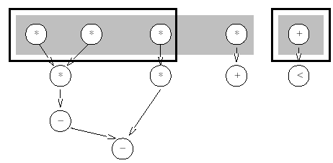
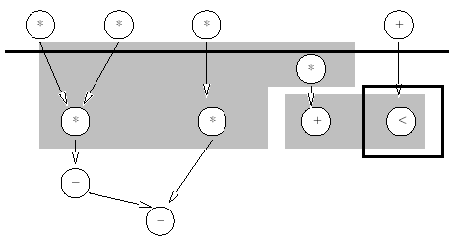
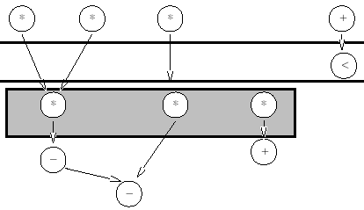
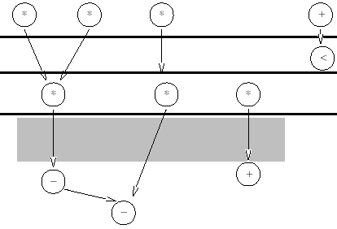
List Scheduling Example
[©Gupta]

Slide 35
List Scheduling Algorithm: MR-LCS
  LIST_R (G(V,E), λ’) {
  a = 1, l = 1
  Compute the ALAP times t^{L}.
  if t₀^{L} < 0
  return (not feasible)
  repeat {
  for each resource type k {
  U_{l,k} = available vertices in V.
  Compute the slacks { s_{i} = t_{i}^{L} - l, ∀ v_{i}∈ U_{l,k} }.
  Schedule operations with zero slack, update a
  Schedule additional S_{k} ⊆ U_{l,k} under a constraints
  }
  l = l + 1
  } until v_{n} is scheduled.
  }

Slide 36
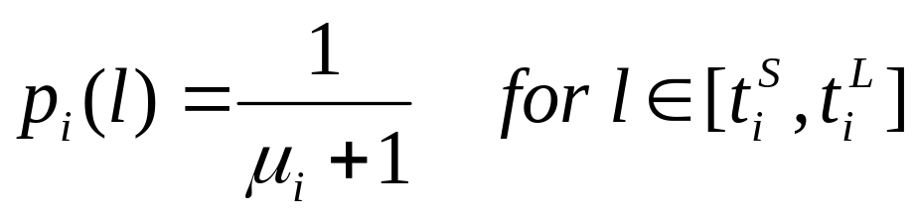
Force-Directed Scheduling
Similar to list scheduling
  Can handle ML-RCS and MR-LCS
  For ML-RCS, schedules step-by-step
  BUT, selection of the operations tries to find the globally best set of operations
Idea:
  Find the mobility μ_{i} = t_{i}^{L} – t_{i}^{S} of operations
  Look at the operation type probability distributions
  Try to flatten the operation type distributions
Definition: operation probability density
  p_{i} ( l ) = Pr { v_{i} starts at step l }.
  Assume uniform distribution:
[©Gupta]

Slide 37
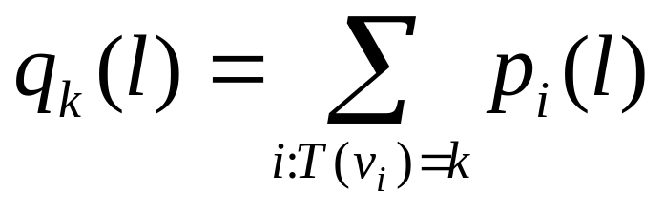
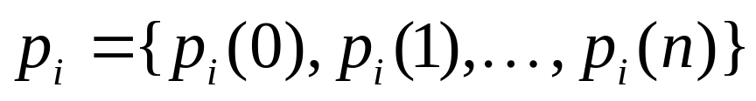
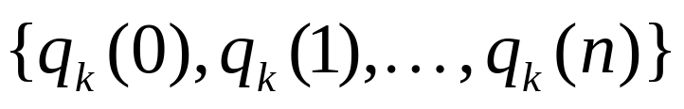
Force-Directed Scheduling: Definitions
Operation-type distribution (NOT normalized to 1)
Operation probabilities over control steps:
Distribution graph of type k over all steps:
  q_{k} ( l ) can be thought of as expected operator cost
  for implementing operations of type k at step l.

Slide 38
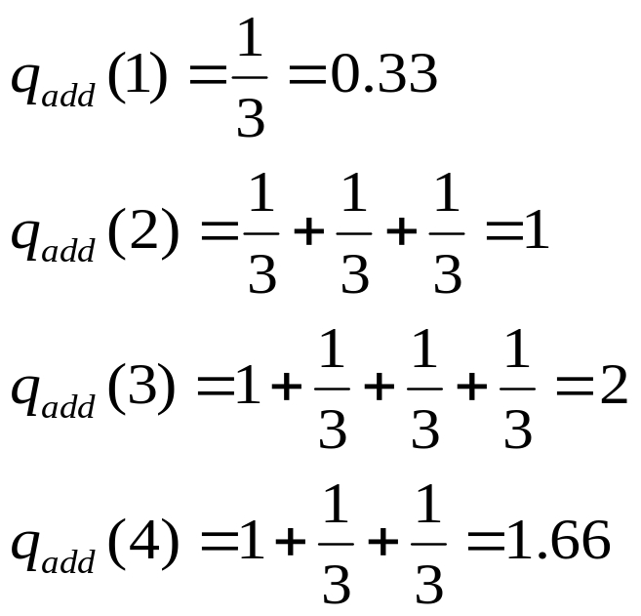
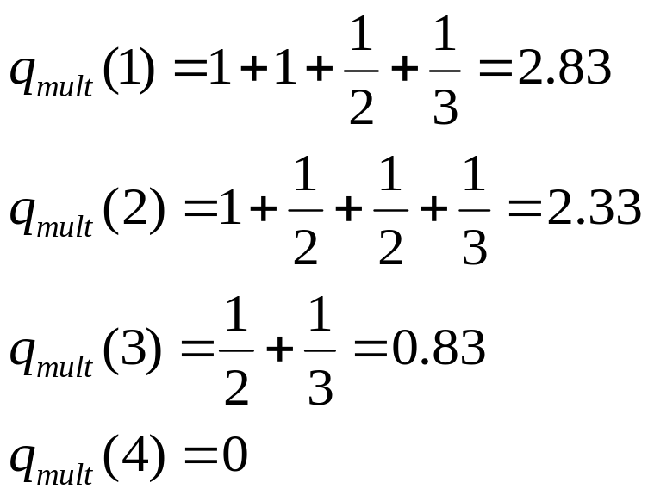
Example
NOP
0.33
1
2.83
×
×
×
×
+
1
×
×
+
<
2.33
2
2
3
-
.83
1.66
-
0
4
NOP

Slide 39
Force-Directed Scheduling Algorithm: Idea
Very similar to LIST_L(G(V,E), a)
  Compute mobility of operations using ASAP and ALAP
  Computer operation probabilities and type distributions
  Select and schedule operations
  Update operation probabilities and type distributions
  Go to next control step
Difference with list sched in selecting operations
  Select operations with least force
  Consider the effect on the type distribution
  Consider the effect on successor nodes and their type distributions

Slide 40
To Probe Further...
Linear programming
  http://www.cs.sunysb.edu/~algorith/files/linear-programming.shtml
Linear programming tools
  http://www-unix.mcs.anl.gov/otc/Guide/faq/linear-programming-faq.html
Automatic complication of pipelined designs
  T. Maruyama and T. Hoshino, “A C to HDL Compiler for Pipeline Processing on FPGAs”, IEEE Symposium on FPGAs for Custom Computing Machines (FCCM), pp. 101-110, 2001.

